Slide 1


Optimization Of Medical Inventory
1

Slide 2


Contents
Business objective
Business Constraints
Project Architecture
Data collection and details
Data Information
Data Dictionary
Exploratory Data Analysis
Data Preprocessing
Data Visualization
Recommendations
Notes:
Change

Slide 3
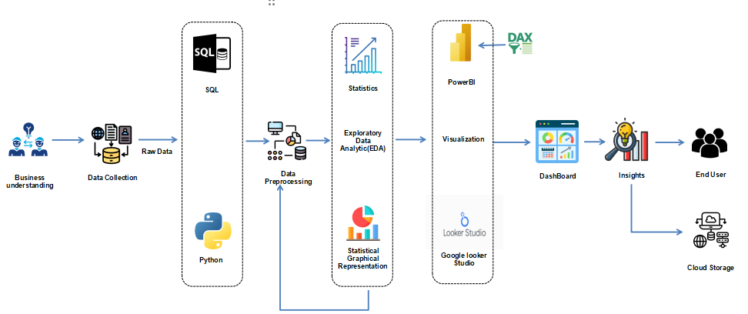
Project Overview and Scope

Slide 4

Business Problem
Bounce rate is increasing significantly leading to the patient dissatisfaction.

Slide 5
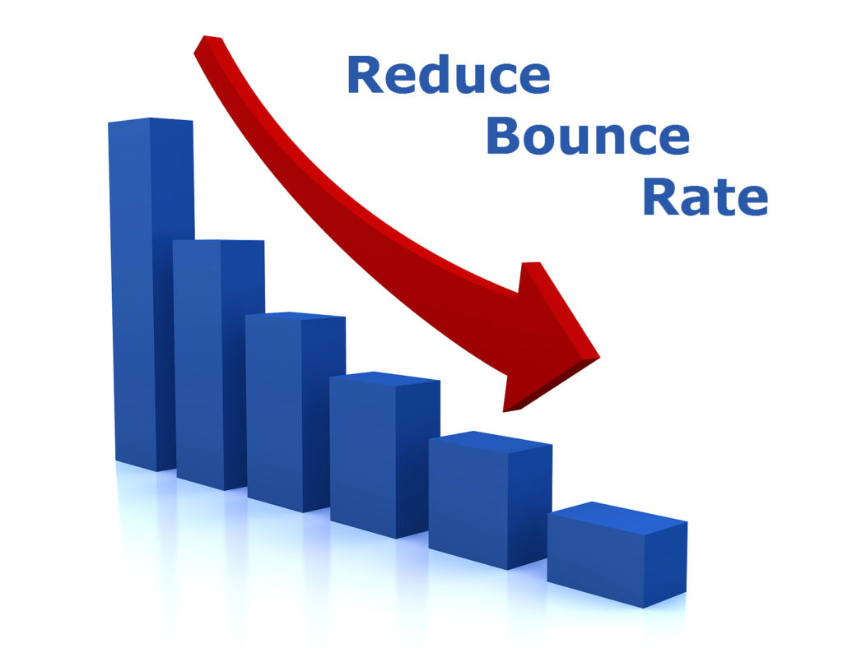

Business Objective
Objective
Minimize bounce rate
Constraints
Minimize inventory cost

Slide 6
CRISP-ML(Q) Methodology: 1.Business and data understanding 2.Data preparation: a. Exploratory Data Analysis(EDA) b. Data Preprocessing 3.Data Visualization: Power BI

Slide 7









Technical Stack
Exploratory Data Analysis(EDA)
and
Data Pre- Processing
Visualization
Python
SQL

Slide 8
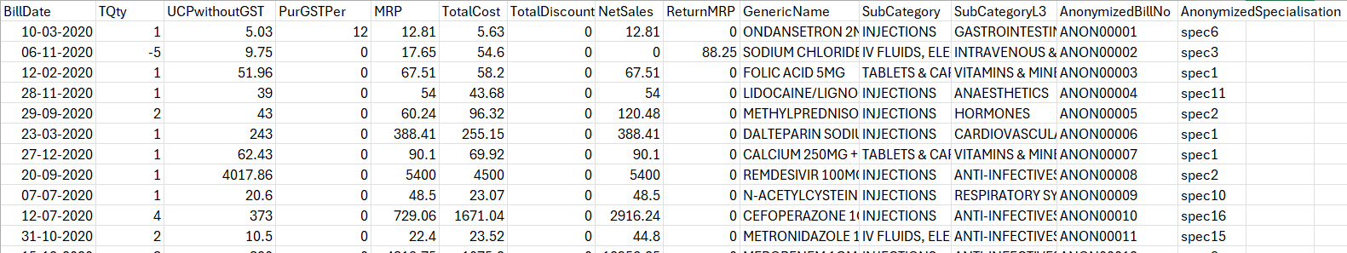
Data Collection and Understanding
Medical Inventory Optimization Dataset:
The shape of the Medical Inventory Optimization Dataset is (85001, 14), indicating that it contains 85001 rows and 14 columns.

Slide 9
Data Information
The dataset includes columns such as BillDate, TQty , UCPwithoutGST , PurGSTPer , MRP , TotalCost , TotalDiscount, NetSales, ReturnMRP, GenericName, SubCategory, SubCategoryL3, AnonymizedBillNo, AnonymizedSpecialisation.
We are primarily focusing on the Quantity and ReturnMRP columns, which serve as output variables. These columns provide information on the quantity of items sold and returned, crucial for assessing inventory turnover rates and identifying potential overstocking or understocking issues.
Additionally, the TotalCost and NetSales columns represent the financial aspects of transactions, including costs and sales amounts. Analyzing these fields is fundamental for assessing profitability and revenue generation.
GenericName and SubCategory fields help identify which drugs are being sold and their categories. This information is essential for understanding product popularity, market demand, and implementing effective inventory management strategies.

Slide 10
Data Dictionary
Sn. No | varialbe name | Variable Description | Data Type
1 | BillDate | Date of purchase of medicine | Date
2 | TQty | Quantity of the drug | Numeric (Integer)
3 | UCPwithoutGST | Unit Cost Price without GST (Goods and Services Tax). | Numeric (Float)
4 | PurGSTPer | Purchase GST Percentage applied on the unit cost price. | Numeric (Float)
5 | MRP | Maximum Retail Price of the item. | Numeric (Float)
6 | TotalCost | Total cost before discounts. | Numeric (Float)
7 | TotalDiscount | Total discount given on the total cost. | Numeric (Float)
8 | NetSales | Net sales amount after applying discounts and adding GST. | Numeric (Float)
9 | ReturnMRP | Maximum Retail Price of returned items | Numeric (Float)
10 | GenericName | Name of the drug | Categorical (String)
11 | SubCategory | Subcategory (Type) to the category of drugs. | Categorical (String)
12 | SubCategoryL3 | Subcategory (condition) to the category of drugs | Categorical (String)
13 | AnonymizedBillNo | An anonymized version of the bill number to maintain privacy. | Categorical (String)
14 | AnonymizedSpecialisation | Anonymized specialization of the prescriber or the person related to the bill to maintain privacy. | Categorical (String)

Slide 11
Exploratory Data Analysis [EDA]
The SAMPLEMIODATA comprises 85001 records and includes essential columns such as BillDate, TQty , UCPwithoutGST , PurGSTPer , MRP , TotalCost , TotalDiscount, NetSales, ReturnMRP, GenericName, SubCategory, SubCategoryL3, AnonymizedBillNo, AnonymizedSpecialisation.
Descriptive statistics for numeric columns (TQty , UCPwithoutGST , PurGSTPer , MRP , TotalCost , TotalDiscount, NetSales, ReturnMRP, ) like mean, median, variance, standard deviation, range, skewness, and kurtosis provide insights into distribution and variability, aiding in inventory planning and risk assessment. Meanwhile, mode for categorical columns (GenericName, SubCategory, SubCategoryL3, AnonymizedBillNo, AnonymizedSpecialisation) offers insights into common types, specializations, formulations, and drug categories, guiding procurement and inventory categorization decisions.
Notes:
EDA is used for seeing what the data can tell us before the modeling task.
Change

Slide 12
Exploratory Data Analysis [EDA]
Before Removing Outliers
First Business Moment
 | TQty | UCPwithoutGST | PurGSTPer | MRP | TotalCost | TotalDiscount | NetSales | ReturnMRP
Mean | 1.714 | 301.492 | 0.203 | 617.923 | 538.696 | 0.00 | 963.848 | 116.061
Mode | 1 | 9.75 | 0 |  |  | 0.0 | 0.0 | 0.0
Median | 1 | 41 | 0.00 | 77.12 | 77.28 | 0.00 | 99.40 | 0.00
Second Business Moment
 | TQty | UCPwithoutGST | PurGSTPer | MRP | TotalCost | TotalDiscount | NetSales | ReturnMRP
Standard Deviation | 3.218 | 1061.085 | 1.628 | 1779.898 | 2128.742 | 0.00 | 3202.453 | 1100.847
Range | 498.0 | 36982.5 | 36.0 | 56399.1 | 121054.5 | 0.0 | 100620.0 | 160801.2
Variance | 1.035 | 1.125 | 2.651 | 3.168 | 4.531 | 0.00 | 1.025 | 1.211

Slide 13
EXPLORATORY DATA ANALYSIS [EDA]
Third Business Moment
 | TQty | UCPwithoutGST | PurGSTPer | MRP | TotalCost | TotalDiscount | NetSales | ReturnMRP
Skewness | 1.035 | 1.125 | 2.6511 | 3.168 | 4.531 | 0.00 | 1.025 | 1.211
Fourth Business Moment
 | TQty | UCPwithoutGST | PurGSTPer | MRP | TotalCost | TotalDiscount | NetSales | ReturnMRP
Kurtosis | 2357.491 | 138.101 | 80.583 | 98.163 | 376.764 | 0.00 | 145.6480 | 5617.403

Slide 14
Exploratory Data Analysis [EDA]
After Removing Outliers
First Business Moment
 | TQty | UCPwithoutGST | PurGSTPer | MRP | TotalCost | TotalDiscount | NetSales | ReturnMRP
Mean | 1.577 | 88.351 | 0.00 | 250.157 | 170.922 | 0.00 | 304.579 | 0.00
Mode | 1.0 | 281.975 | 0.0 |  |  | 0.0 | 1104.975 | 0.00
Median | 1.00 | 41.00 | 0.00 | 77.12 | 77.28 | 0.00 | 99.40 | 0.00
Second Business Moment
 | TQty | UCPwithoutGST | PurGSTPer | MRP | TotalCost | TotalDiscount | NetSales | ReturnMRP
Standard Deviation | 1.201 | 98.891 | 0.00 | 321.175 | 198.219 | 0.00 | 394.347 | 0.00
Range | 381.500 | 281.975 | 0.00 | 1006.990 | 584.640 | 0.00 | 1104.975 | 0.00
Variance | 1.442 | 9779.505 | 0.00 | 103153.532 | 39290.817 | 0.00 | 155509.861 | 0.00

Slide 15
EXPLORATORY DATA ANALYSIS [EDA]
Third Business Moment
 | TQty | UCPwithoutGST | PurGSTPer | MRP | TotalCost | TotalDiscount | NetSales | ReturnMRP
Skewness | 0.022 | 1.094 | 0.00 | 1.380 | 1.201 | 0.00 | 1.207 | 0.00
Fourth Business Moment
 | TQty | UCPwithoutGST | PurGSTPer | MRP | TotalCost | TotalDiscount | NetSales | ReturnMRP
Kurtosis | -0.718 | -0.356 | 0.00 | 0.57 | -0.0498 | 0.00 | -0.144 | 0.00

Slide 16
Data Preprocessing
Performed EDA preprocessing in Python and MySQL
Checked for null values using df.isnull().sum() .There are no null values in the data.
Checked for duplicates in main columns and find there are no duplicates.
Coming to type casting, change the date format according to need for doing analysis
Checked for outliers and get to know that every numerical column as outliers
Performed outliers treatment using IQR method with using upper limit and lower limit method
df1 = pd.DataFrame(np.where(df[numerical_columns] > upper_limit, upper_limit, np.where(df[numerical_columns]< lower_limit, lower_limit, df[numerical_columns])))

Slide 17
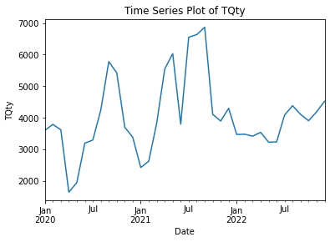
Data Visualization
Time series plot between sum of total quantity sold
Here we can see that in the period of July-October in every year has more quantities sold

Slide 18
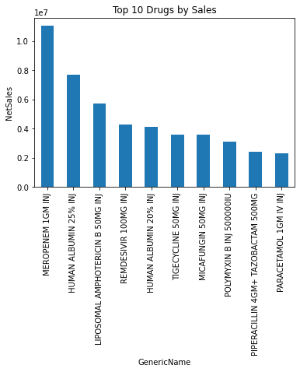
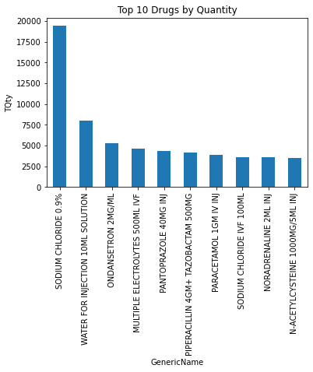
Top 10 drug by Net sales and sold quantity
First chart shows top 10 drug by Net Sales where MEROPENEM 1GM with worth of 1461725.27, followed by HUMAN ALBUMIN 25% Injection
Second chart shows top 10 drug by quantity sold where SODIUM CHLORIDE 0.9% is the most sold drug

Slide 19
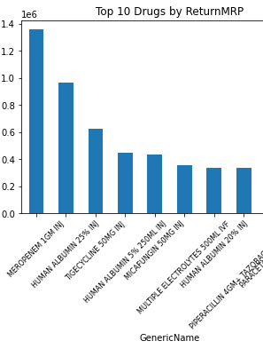
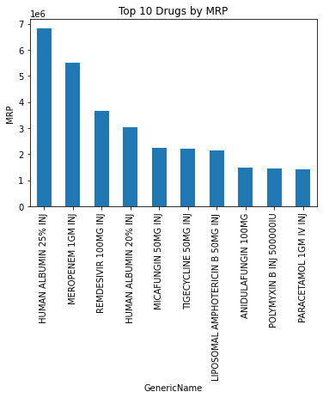
Top 10 drugs by MRP and Return MRP
First chart show top 10 drugs by their Return MRP where MEROPENEM 1GM Injection as most return MRP value
Second chart shows top 10 drugs by their MRP where HUMAN ALBUNIM 25% Injection as most MRP value

Slide 20
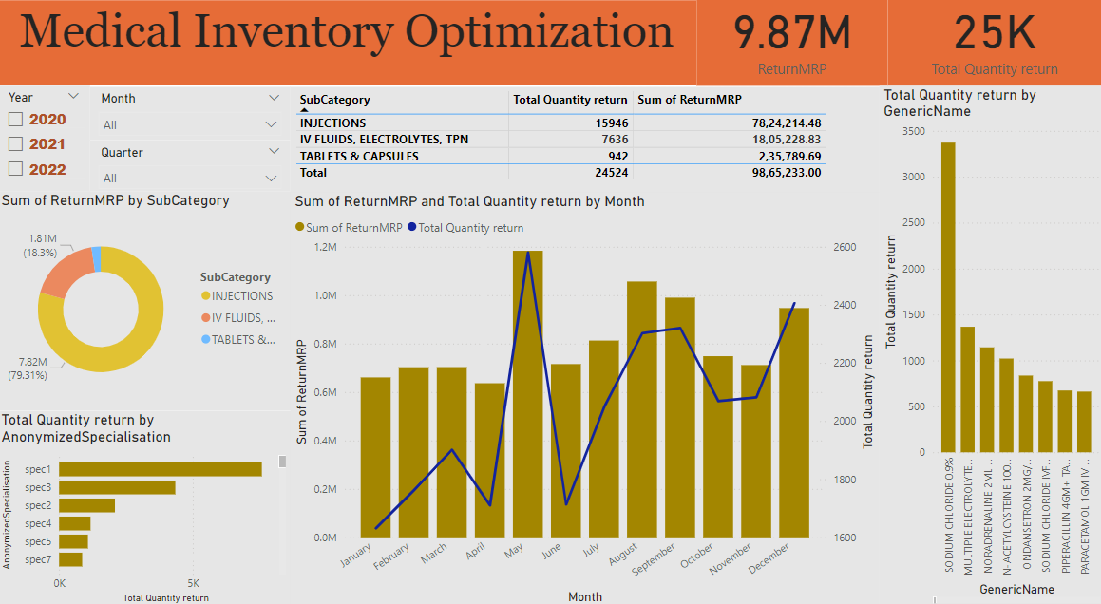
Power Bi Dashboard-1
This dashboard analyzes medical inventory returns, showing a total Return MRP of 9.87M from 25k return items. Key filters include year, month, and quarter. Injections lead with a Return MRP of 7.82M (79.31%). Visuals highlight monthly and yearly trends, with Sodium Chloride highest quantity returned.

Slide 21
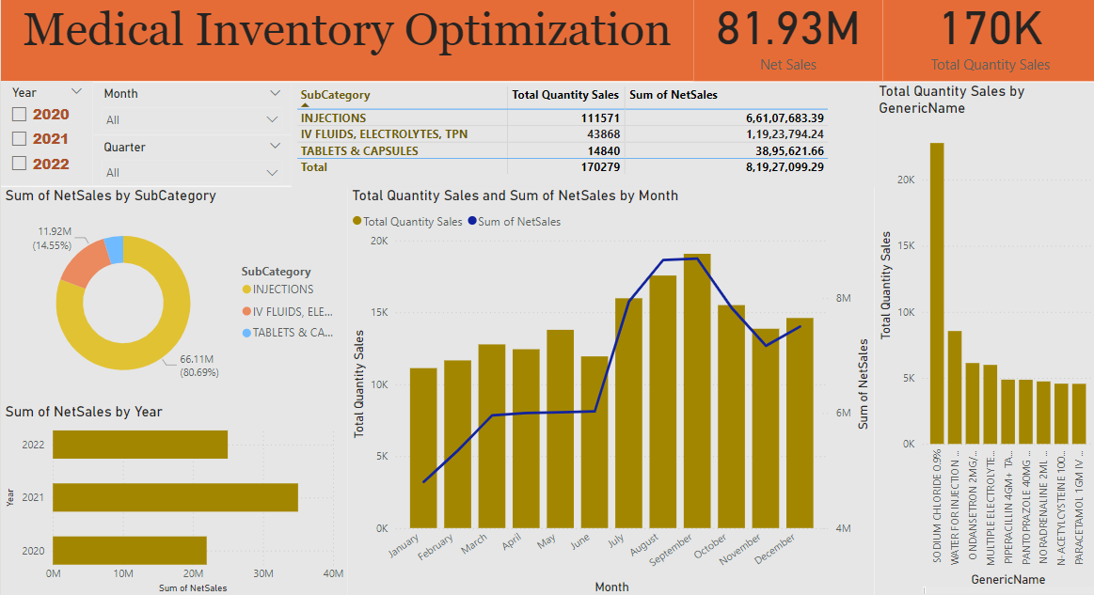
Power Bi Dashboard-2
This dashboard analyzes medical inventory optimization, highlighting 81.93M in net sales from 170K items. Key filters include year, month, and quarter. Injections lead with 66.11M in net sales (80.69%). Visuals show monthly and yearly trends, with Sodium Chloride 0.9% having the highest quantity sold.

Slide 22
Business Insights
Total number of 170279 quantities are sold while 24524 quantities are return
September as more quantities sold with value of 16750 followed by August, July, October with 15258, 13930, 13432. Whereas January month as least quantity sale with 9489.
Coming to weeks, 37th week has more quantities sold with value of 4217 followed by 36th, 38th, 34th, with 4084, 4044,3626. Whereas 52nd week has less with 1938.
2021 year has most sold quantities with 56605 followed by 2022 and 2020 with 45552 and 43598.
In 2021 May has more quantities sold with value of 1231, followed by 2021-July , 2021-August with 1010 and 972. And Sodium Chloride 0.9% is the top one.
Overall, May months has more quantities return with value of 2580 followed by December ,September and August with 2406, 2320, 2302 values.
Sodium Chloride 0.9% is the highest sold quantity with value of 19412 followed by Water For Injection 10ML solutions, Ondansetron 2MG/ML and Multiple Electrolytes 500ML IVF with 8039, 5288 and 4617 values.

Slide 23
Recommendations
Collaborate with Specialization1 and Specialization3 to understand reason for returns, implement tailored strategies to reduce returns
Implement streamlined return processes, improve inventory management, and address Spec1 ,3 issues contributing to returns.
Allocate resources based on seasonal demands, increase operations, inventory, and staffing during busy months, optimize resources during slow months.
Analyse ‘INJECTIONS’ and ‘TABLETS & CAPSULES’ for higher returns, address issuing causing returns, enhance customer satisfaction, and product quality.

Slide 24

THANK YOU

